Slide 1

Fingerprint Identification
System

Slide 2
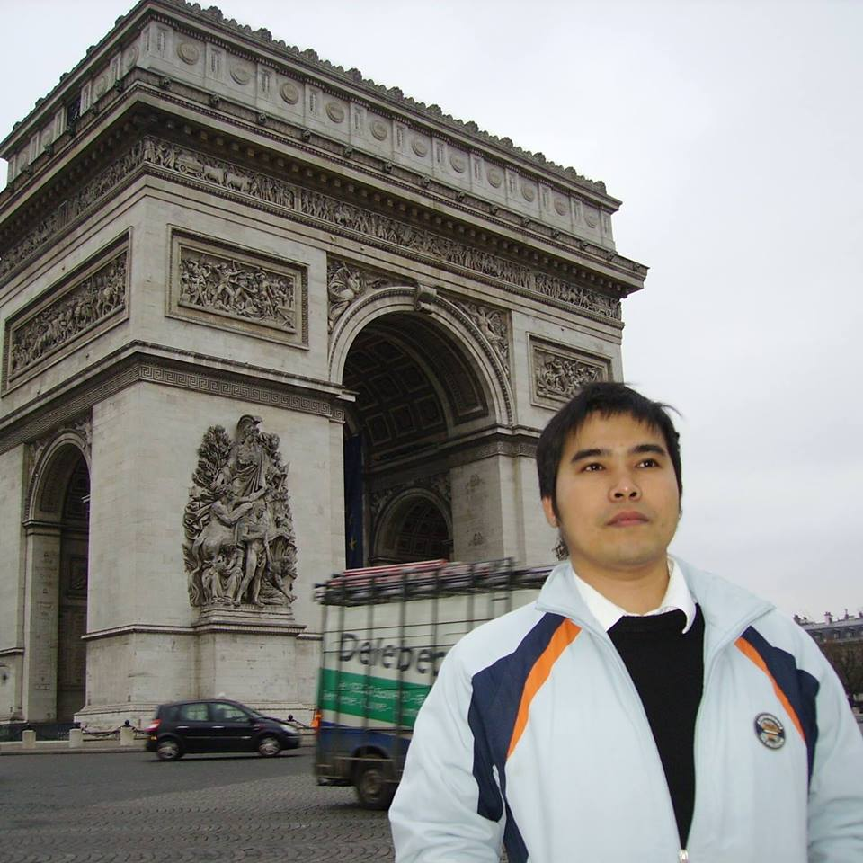
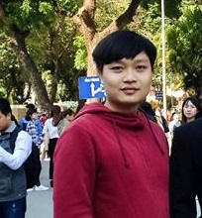
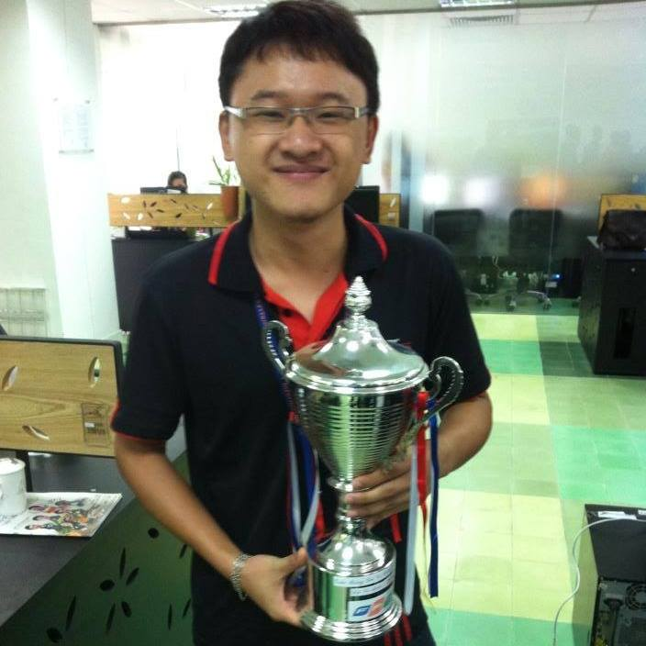
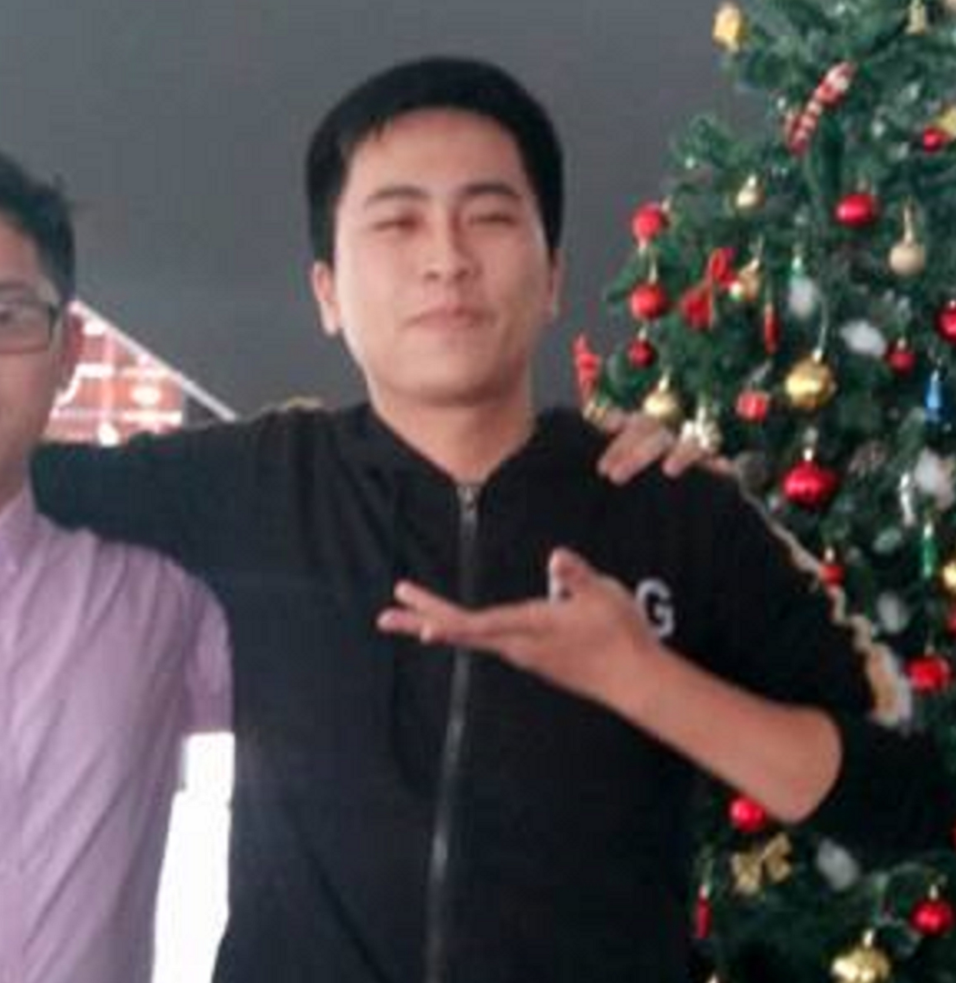

Supervisor
Ph. D Phan Duy Hung
Team Leader
Le Dinh Huynh
Technical Leader
Nguyen Van Nam
Developer, Tester
Pham Duc Hiep
Developer, Q&A
Bui Quang Huy

Slide 3
Content
1
Introduction
2
Project Management Plan
3
Scientific Basis & Some Characteristics of The Fingerprint
4
Algorithm
5
Hardware Design
6
Application Module
7
Lesson Learned – Demo – Q&A

Slide 4
Introduction

Slide 5
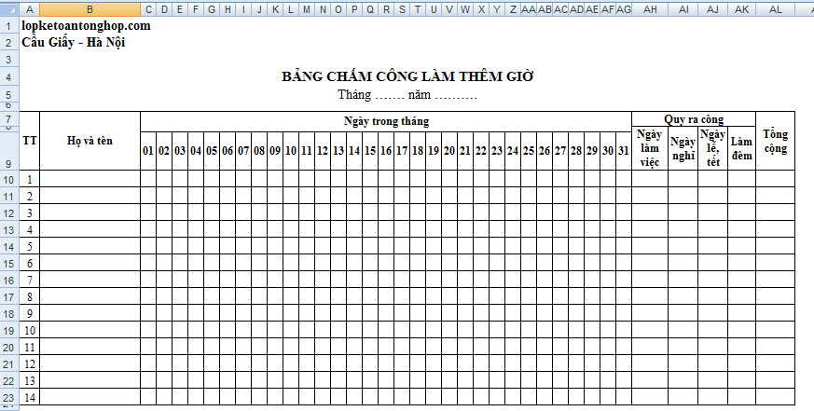
Background

Slide 6

Our Idea

Slide 7
Literature Review
In research of Mouad. M. H. Ali, Vivek H. Mahale and Yannawar Pravin
"Fingerprint Recognition for Person Identification and Verification Based on Minutiae Matching," IEEE, 28 Feb. 2016
Acquisition
Capture the fingerprint image
Pre-processing
Enhancement
Feature Extraction
Extract the feature
Matching
Binarization
Thinning
Match two minutiae points
Result
FAR = 0.0154 and FRR = 0.0137
Accuracy : 98.55%.

Slide 8
Literature Review
Ridouane Oulhiq, Saad Ibntahir, Marouane Sebgui, Zouhair Guennoun
"A fingerprint recognition framework using Artificial Neural Network," IEEE, 17 December 2015.
Artificial Neural Network (ANN)
Result
Accuracy : 81%.

Slide 9
Main Objectives
Learn Research methods.
Aims to build a system that is reliability as much as possible.
Running towards the goal build a system to satisfy specific business group (small company).
The limitation of Processing Speed

Slide 10
Project Management Plan

Slide 11
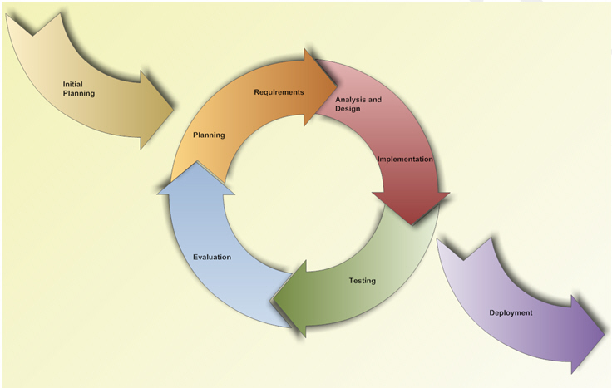
Software Process Model
Interactive and Incremental Model

Slide 12
Teamwork
Time: 3 hours / day, 3 days / week
Location: FPT University Hoa Lac
Communication:
Supervisor meeting: Once a week
Teambuilding: Once a week

Slide 13
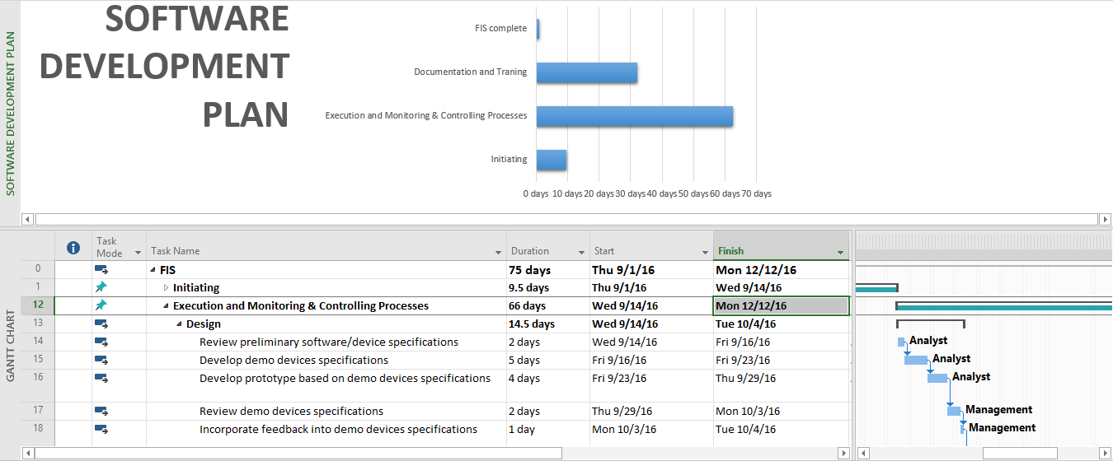
Project Planning

Slide 14









Visual Studio
2015
Github
V2.11
Matlab
V8.5
SQLite
V3.15.2
Smart GIT
V7.1
Risk Management
Description | Avoidance plan | Contingency plan | Status
Miscommunication | Meeting report and daily report should be a best solution. Always store final decision or idea into report. Beside we can use 5-why to find out the problems | When it becomes clear that miscommunication is causing problems, the team members are gathered in a meeting to clear things up. | Closed
Time shortage | PM should create more spare time and calculate plus 20% buffer time. | Lacking time is the fatal problem, can run project to failure. PM should analysis and has change on the next phase. | Closed
Design Errors | The design should be reviewed very critically. PM or team leader should be consulted frequently on his opinion about the feasibility and the correctness of certain design decisions. | When errors in the design are noticed PM or team leader should be consulted to help correct the design errors as soon as possible. Also all the work, that depends on the faulty design, should be halted until the error is corrected. | Closed
Illness or absence of team members | Team members should warn their team leader or the PM timely before a planned period of absence. | By ensuring that knowledge is shared between team members, work can be taken over quickly by someone else if a person gets ill. | Closed
Requirement changed | Carefully brainstorm system’s features among team members. Regularly hold meeting to define and discuss all features of systems. Design system carefully. Analyze all the possible cases to minimize the change. | Team meetings with supervisor to determine whether new feature should be implemented or not. Team leaders create implementation plan for implemented features and send to team members. | Closed
Hardware malfunction | Always keep in touch with Supervisor and provider for backup option | Asking supervisor for using sup-hardware while team members are going out and take another hardware | Closed
Sublime Text
V2.2
Balsamiq Mockup
V3.5.5
Google Chrome
v47
Microsoft Office
2013
Postman
V4.9

Slide 15
Tools & Technologies
Visual Studio
2015
Github
V2.11
Matlab
V8.5
SQLite
V3.15.2
Smart GIT
V7.1
Sublime Text
V2.2
Balsamiq Mockup
V3.5.5
Google Chrome
v47
Microsoft Office
2016
Postman
V4.9
Notes:
1, Postman: Postman is the swiss army knife of API tools, allowing you to design, build, test, document and monitor your services, all in one place.
Used for: testing HTTP POST

Slide 16










Tools & Technologies
Wiring Pi
V2.29
OpenCV
V3.1
Cmake
V3.7
Manjaro
V16.10.3
Raspian
VI/VIM
V8.0.0022
Fritzing
Sql Server
2014
Slack
Ubuntu
V16.04
Notes:
1, wiringPi: WiringPi is a GPIO access library written in C for the BCM2835 used in the Raspberry Pi.
2, Cmake: The cross-platform, open-source make system. CMake is used to control the software compilation process using simple platform and compiler independent configuration files.
3, Manjaro: Manjaro Linux, or simply Manjaro, is a Linux distribution based on Arch Linux.
4, VI/VIM: Vim is designed for use both from a command-line interface and as a standalone application in a graphical user interface.
5, Fritzing: an open-source hardware initiative that makes electronics accessible as a creative material for anyone.

Slide 17
Content
1
Introduction
2
Project Management Plan
3
Scientific Basis & Some Characteristics of The Fingerprint
4
Algorithm
5
Hardware Design
6
Application Module
7
Lesion Learned – Demo – Q&A

Slide 18
Scientific Basis &
Some Characteristics
of The Fingerprint

Slide 19
Scientific basis of fingerprint identification
Scientists pointed that:
Each person's fingerprint is constant throughout life.
No two identical fingerprints yet.
the probability that 2 fingers are alike is about
1 in 6.4x10^10
Notes:
Năm 1868 nhà bác học Roberts chỉ ra rằng mỗi ngón tay có một môi trường phát triển vi mô khác nhau; ngoài ra ngón tay cái và ngón tay trỏ còn phải chịu thêm một vài tác động môi trường riêng. Vì vậy, vân tay trên mười đầu ngón tay của một cá nhân là khác nhau. - See more at: http://powerofmind.vn/sinh-trac-van-tay-dua-tren-co-khoa-hoc-nao/#sthash.hcGZSTK6.dpuf
http://pda-genius.vn/view/5-co-so-khoa-hoc-cua-sinh-trac-van-tay.html

Slide 20
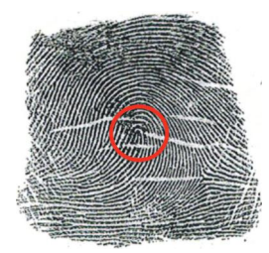
Some characteristics of fingerprints
Global level
Loop
Whorls
Arches

Slide 21
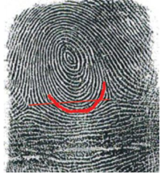
Some characteristics of fingerprints
Global level
Loop
Whorls
Arches

Slide 22
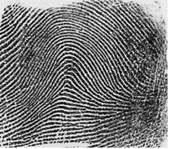
Some characteristics of fingerprints
Global level
Loop
Whorls
Arches

Slide 23
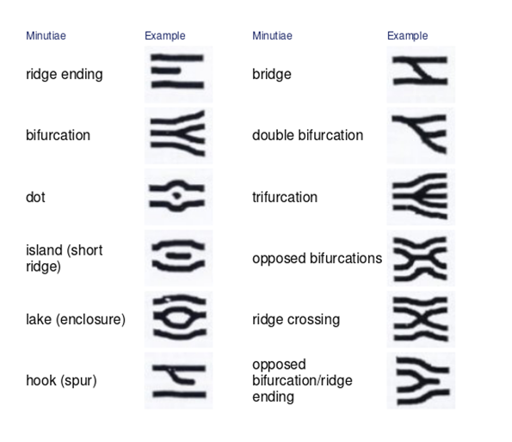


Some characteristics of fingerprints
Local level
Minutiae
Notes:
Local fingerprint ridge singularities (những vân kỳ dị) phương pháp truyền thống mà các pháp y sử dụng.
The most common local singularities are ridge endings(điểm kết thúc của 1 vân ) and ridge bifurcations (điểm rẽ nhánh của vân )

Slide 24
Some characteristics of fingerprints
Local level
Minutiae
ridge endings
ridge bifurcations
Notes:
Local fingerprint ridge singularities (những vân kỳ dị) phương pháp truyền thống mà các pháp y sử dụng.
The most common local singularities are ridge endings(điểm kết thúc của 1 vân ) and ridge bifurcations (điểm rẽ nhánh của vân )

Slide 25
Algorithm

Slide 26
Algorithm
Approach
Matching
Correlation-based matching
Minutiae-based matching
Deep-learning
Ridge feature-based matching
…
deep neural networks
convolutional deep neural networks
deep belief networks
recurrent neural networks
…

Slide 27
Algorithm
Approach
Matching
Correlation-based matching
Minutiae-based matching
Deep learning
Ridge feature-based matching
…
deep neural networks
convolutional deep neural networks
deep belief networks
recurrent neural networks
…

Slide 28
Feature extraction

Slide 29
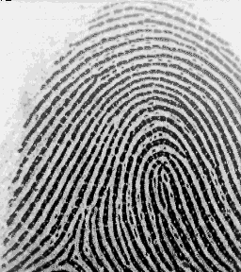
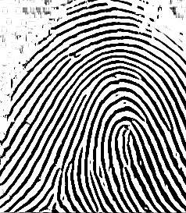


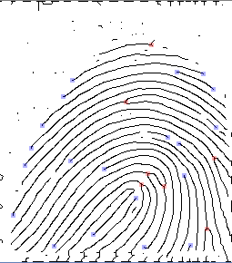
Feature extraction
ABCD

Slide 30
Feature extraction
INPUT IMAGE

Slide 31
Feature extraction
ENHANCE

Slide 32
Feature extraction
BINARIZATION

Slide 33
Feature extraction
THINNING

Slide 34
Feature extraction
MINUTIAE DETECTION

Slide 35
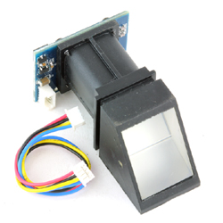
Feature extraction
0. IMAGE ACQUISITION
ENHANCEMENT
BINARIZATION
THINNING
MINUTIAE DETECTION
Command package
Upper Computer
Acknowledge package

Slide 36
Feature extraction
0. IMAGE ACQUISITION
GRAY SCALE ENHANCEMENT
BINARIZATION
THINNING
MINUTIAE DETECTION
Package format
Header | Adder | Package identifier | Package length | Package content | Checksum
2 bytes | 4 bytes | 1 byte | 2 bytes | - | 2 bytes
Acknowledge package
Command package
Upper Computer

Slide 37
Feature extraction
Header | Adder | Package identifier | Package length | Package content | Checksum
2 bytes | 4 bytes | 1 byte | 2 bytes | - | 2 bytes
0. IMAGE ACQUISITION
GRAY SCALE ENHANCEMENT
BINARIZATION
THINNING
MINUTIAE DETECTION
Name | Symbol | Description
Package Identifier | PID | 01H | Command Packet.
 |  | 02H | Data packet.
 |  | 07H | Acknowledge packet.
 |  | 08H | End of Data packet.
Package contents | DATA | It can be commands, data, command’s parameters, acknowledge result, etc.

Slide 38
Feature extraction
0. IMAGE ACQUISITION
GRAY SCALE ENHANCEMENT
BINARIZATION
THINNING
MINUTIAE DETECTION
Used Command
Used Command
 | Header | Adder | Package identifier | Package length | Package content (Instruction code) | Checksum
GenImg | 0xEF01 | 0xFFFFFFFF | 01H | 03H | 01H | 05H
Acknowledge Package
Acknowledge Package
 | Header | Adder | Package identifier | Package length | Package content (Instruction code) | Checksum
 | 0xEF01 | 0xFFFFFFFF | 07H | 03H | xxH | sum
Acknowledge package
Confirmation code=00H: Figner collection success. Confirmation code=01H: Error when receiving package. Confirmation code=02H: Can’t detect finger.
Confirmation code=03H: Fail to collect finger.
Command package
 | Header | Adder | Package identifier | Package length | Package content (Instruction code) | Checksum
GenImg | 0xEF01 | 0xFFFFFFFF | 01H | 03H | 01H | 05H
Upper Computer
 | Header | Adder | Package identifier | Package length | Package content (Instruction code) | Checksum
 | 0xEF01 | 0xFFFFFFFF | 07H | 03H | xxH | sum
Confirmation code=00H: Figner collection success. Confirmation code=01H: Error when receiving package. Confirmation code=02H: Can’t detect finger.
Confirmation code=03H: Fail to collect finger.

Slide 39
Feature extraction
0. IMAGE ACQUISITION
GRAY SCALE ENHANCEMENT
BINARIZATION
THINNING
MINUTIAE DETECTION
Used Command
Used Command
 | Header | Adder | Package identifier | Package length | Package content (Instruction code) | Checksum
UpImage | 0xEF01 | 0xFFFFFFFF | 01H | 03H | 0aH | 000eH
Acknowledge Package
Acknowledge Package
Acknowledge package
 | Header | Adder | Package identifier | Package length | Package content (Instruction code) | Checksum
 | 0xEF01 | 0xFFFFFFFF | 07H | 03H | xxH | sum
Confirmation code=00H: Ready to transfer the following data packet. Confirmation code=01H: Error when receiving package. Confirmation code=0FH: Fail to transfer the following data packet.
Command package
 | Header | Adder | Package identifier | Package length | Package content (Instruction code) | Checksum
GenImg | 0xEF01 | 0xFFFFFFFF | 01H | 03H | 01H | 05H
Upper Computer
 | Header | Adder | Package identifier | Package length | Package content (Instruction code) | Checksum
 | 0xEF01 | 0xFFFFFFFF | 07H | 03H | xxH | sum
Confirmation code=00H: Figner collection success. Confirmation code=01H: Error when receiving package. Confirmation code=02H: Can’t detect finger.
Confirmation code=03H: Fail to collect finger.

Slide 40

Feature extraction
0. IMAGE ACQUISITION
GRAY SCALE ENHANCEMENT
BINARIZATION
THINNING
MINUTIAE DETECTION
1. Command package
Upper Computer
Convert Process
2. Data package
transfer

Slide 41
Feature extraction
0. IMAGE ACQUISITION
ENHANCEMENT
BINARIZATION
THINNING
MINUTIAE DETECTION
Why?
Fingerprint images are rarely of perfect quality.
They may be degraded and corrupted due to variations in skin and impression conditions.
Gabor Filter.

Slide 42
Feature extraction
0. IMAGE ACQUISITION
ENHANCEMENT
BINARIZATION
THINNING
MINUTIAE DETECTION
Why?
Fingerprint images are rarely of perfect quality.
They may be degraded and corrupted due to variations in skin and impression conditions.
Gabor Filter.

Slide 43
Feature extraction
0. IMAGE ACQUISITION
ENHANCEMENT
BINARIZATION
THINNING
MINUTIAE DETECTION
Why?
Fingerprint images are rarely of perfect quality.
They may be degraded and corrupted due to variations in skin and impression conditions.
Gabor Filter.

Slide 44
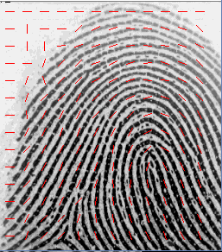
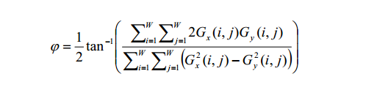
Gabor Filter
Feature extraction
0. IMAGE ACQUISITION
ENHANCEMENT
BINARIZATION
THINNING
MINUTIAE DETECTION
Divide image MxN pixel into smaller block WxW pixel
Find gradient in x-axis and y-axis (Gx and Gy) in each pixel within block.

Slide 45
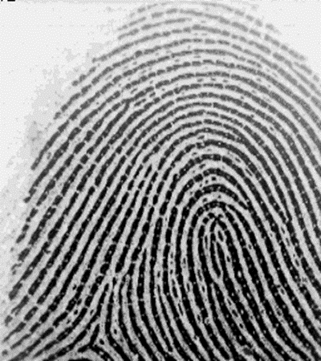
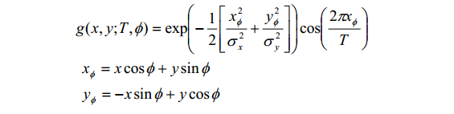
Gabor Filter
Feature extraction
0. IMAGE ACQUISITION
ENHANCEMENT
BINARIZATION
THINNING
MINUTIAE DETECTION
φ direction of the filter.
T is the cycle of the function Cos
σx , σy are the standard deviation

Slide 46
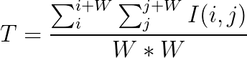
Feature extraction
0. IMAGE ACQUISITION
GRAY SCALE ENHANCEMENT
BINARIZATION
THINNING
MINUTIAE DETECTION
Calculate the mean gray-level (Threshold) of all the pixels within the block(WxW).

Slide 47

Feature extraction
Calculate the mean gray-level (Threshold) of all the pixels within the block(WxW).
0. IMAGE ACQUISITION
GRAY SCALE ENHANCEMENT
BINARIZATION
THINNING
MINUTIAE DETECTION
Binary the pixels within the block(WxW)
The pixel that gray-level value is greater than T will be assign to white (255)
The pixel that gray-level value is smaller than T will be assign to black (0)

Slide 48
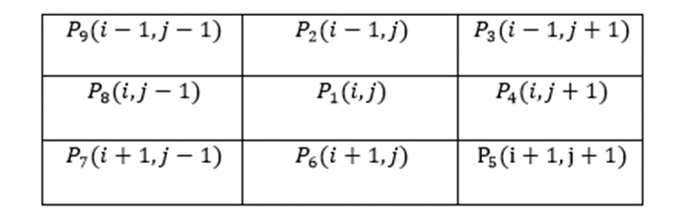
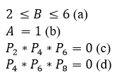
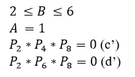
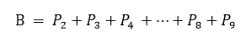
Feature extraction
ZhangSuen Thinning.
It consists of two sub-iterations
0. IMAGE ACQUISITION
GRAY SCALE ENHANCEMENT
BINARIZATION
THINNING
MINUTIAE DETECTION
First sub-iteration
A is the number of the “01” patterns in the clockwise order.
Second sub-iteration

Slide 49
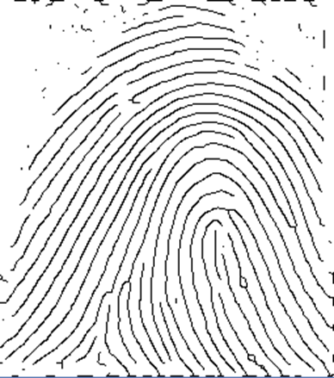
Feature extraction
0. IMAGE ACQUISITION
GRAY SCALE ENHANCEMENT
BINARIZATION
THINNING
MINUTIAE DETECTION

Slide 50
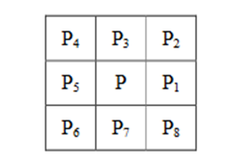
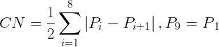
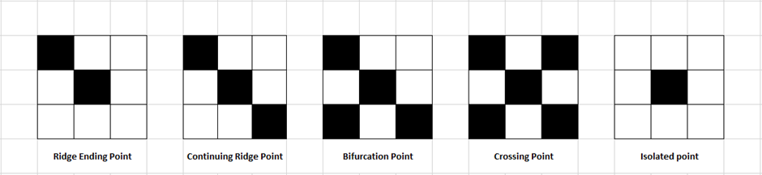
Feature extraction
Crossing Number
0. IMAGE ACQUISITION
GRAY SCALE ENHANCEMENT
BINARIZATION
THINNING
MINUTIAE DETECTION
CN | Property
0 | Isolated Point
1 | Ridge Ending Point
2 | Continuing Point
3 | Bifurcation Point
4 | Crossing Point

Slide 51
Remove false Minutiae
Feature extraction
0. IMAGE ACQUISITION
GRAY SCALE ENHANCEMENT
BINARIZATION
THINNING
MINUTIAE DETECTION
Rules
Rule1: If the distance between termination and bifurcation is less than D, then remove this minutiae.
Rule 2: If the distance between two bifurcations is less than D, then remove this minutiae.
Rule 3: If the distance between two terminations is less than D, then remove this minutiae.

Slide 52
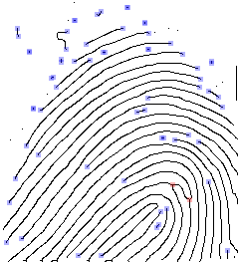
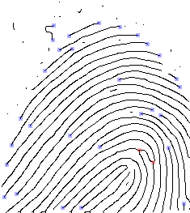
Feature extraction
4. MINUTIAE DETECTION

Slide 53
Feature extraction
4. MINUTIAE DETECTION

Slide 54
Recognition
MINUTIAE BASED METHODS
NEURAL NETWORK

Slide 55
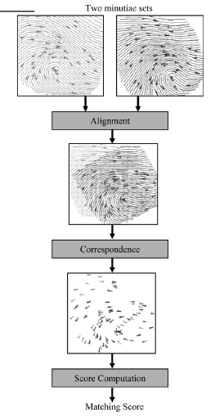
Recognition
MINUTIAE BASED METHODS
NEURAL NETWORK ALGORITHM

Slide 56
Recognition
MINUTIAE BASED METHODS
Result
Database: 12x5 images.
Error min rate = 7.1%
NEURAL NETWORK ALGORITHM

Slide 57
Recognition
MINUTIAE BASED METHODS
NEURAL NETWORK

Slide 58
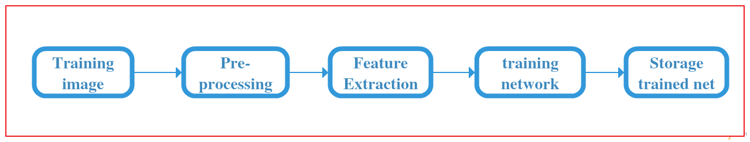
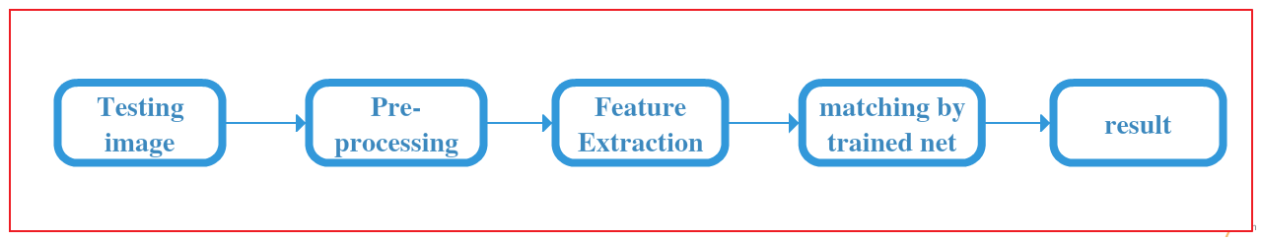
Recognition
NEURAL NETWORK
Process
Net
Perceptron
Input layer
Result
Training
Testing

Slide 59
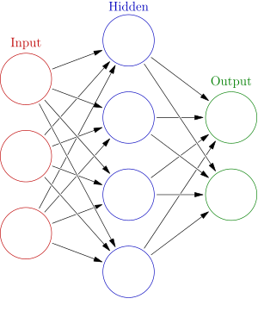
Recognition
NEURAL NETWORK
Process
Net
Perceptron
Input layer
Result
Training
Testing

Slide 60
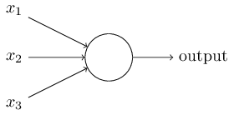
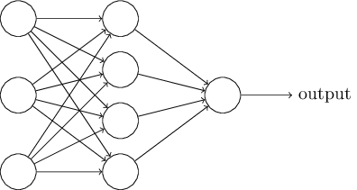
Recognition
NEURAL NETWORK
Process
Net
Perceptron
Input layer
Result
2-layered
Training
Testing
3-layered

Slide 61
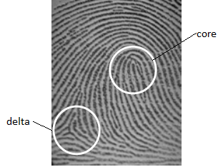
Recognition
NEURAL NETWORK
Process
Net
Perceptron
Input layer
Result
Training
Testing

Slide 62
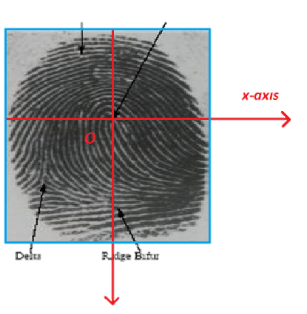
Recognition
NEURAL NETWORK
Process
Net
Perceptron
Input layer
Result
Training
Testing

Slide 63
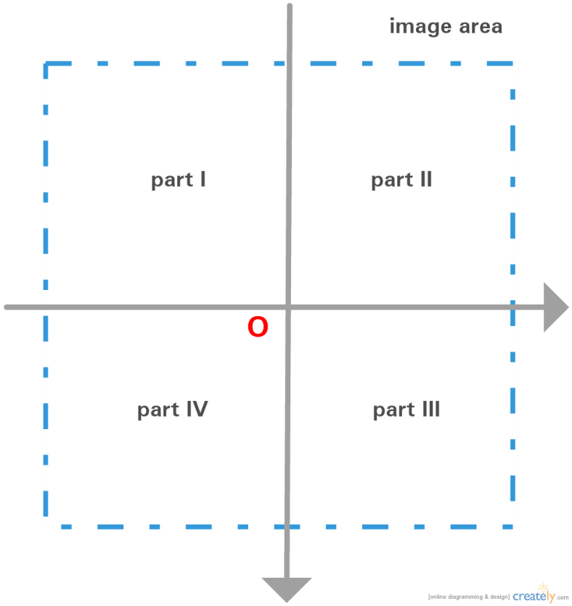
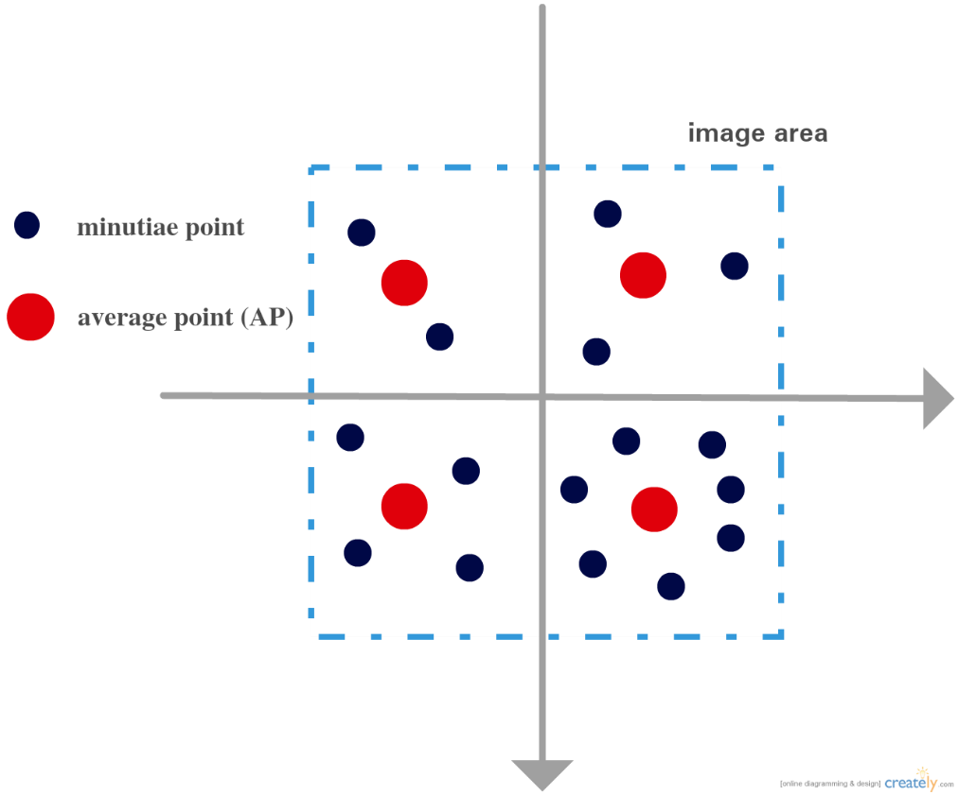
Recognition
NEURAL NETWORK
Process
Net
Perceptron
Input layer
Result
Training
Testing

Slide 64
Recognition
NEURAL NETWORK
Process
Net
Perceptron
Input layer
Result
Training
Testing

Slide 65
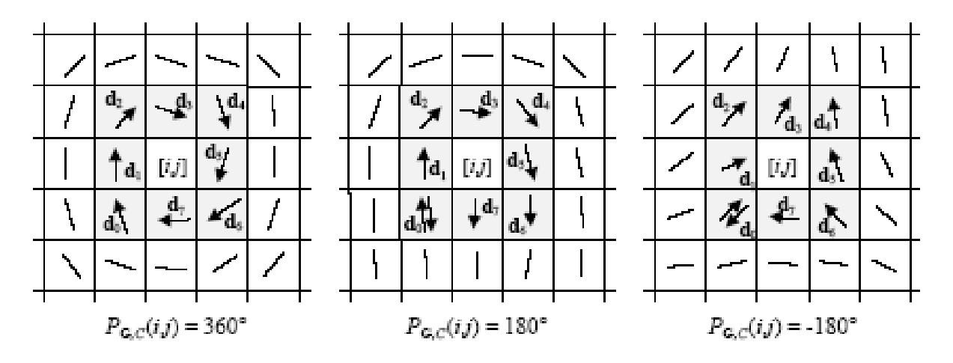
Recognition
NEURAL NETWORK
Process
Net
Perceptron
Input layer
Result
Training
Testing
Orientation map & Poincaré index.

Slide 66
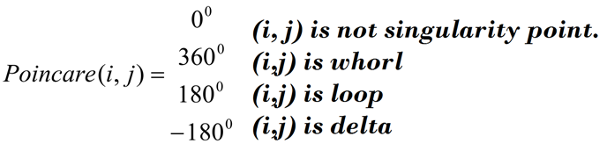
Recognition
NEURAL NETWORK
Process
Net
Perceptron
Input layer
Result
Training
Testing
Orientation map & Poincaré index.

Slide 67
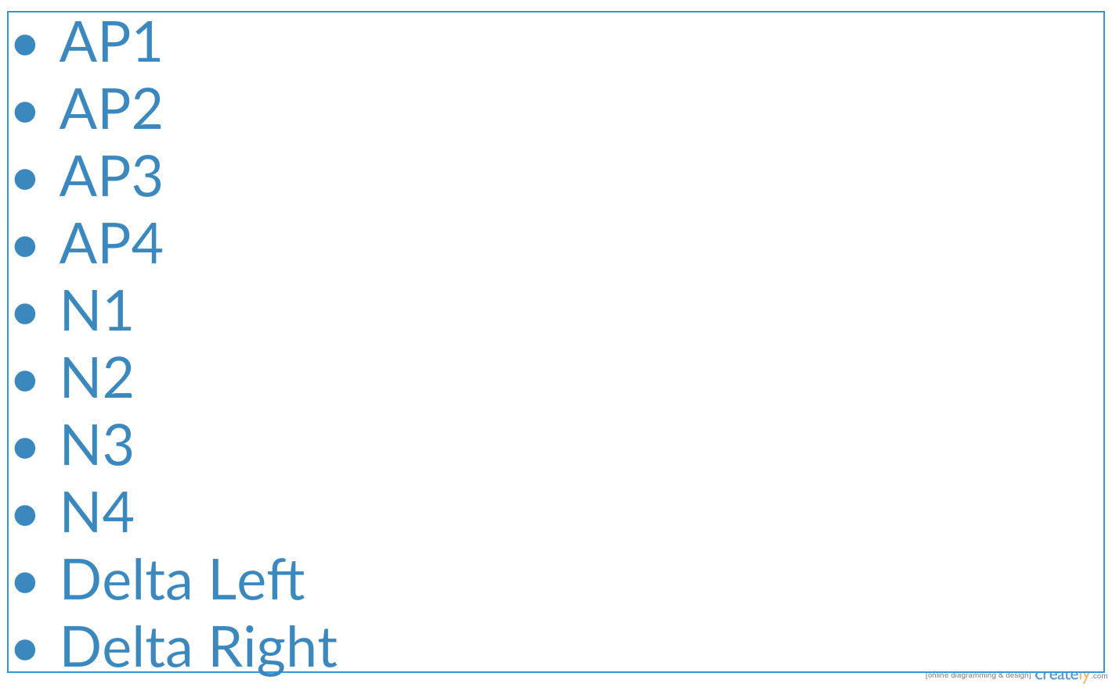
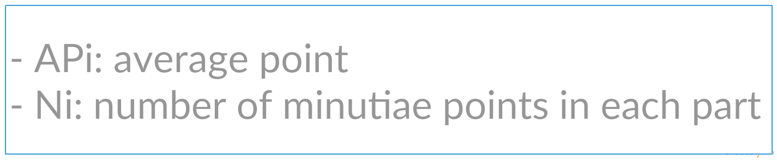
Recognition
NEURAL NETWORK
Process
Net
Perceptron
Input layer
Result
Training
Testing
Orientation map & Poincaré index.

Slide 68
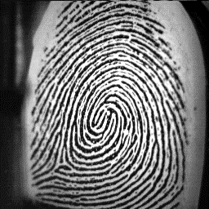
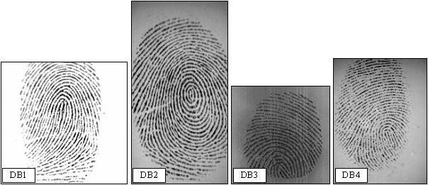
Recognition
NEURAL NETWORK
Process
Net
Perceptron
Input layer
Result
(1+3)*5 images from Oishi DB
FVC2002: 110 * 4 images
NIST Special Database 4
Training
Testing
Orientation map & Poincaré index.

Slide 69
Recognition
NEURAL NETWORK
Process
Net
Perceptron
Input layer
Result
20 images from Oishi DB
FVC2002: 110 * 4 images
NIST Special Database 4
Training
Testing
Orientation map & Poincaré index.

Slide 70
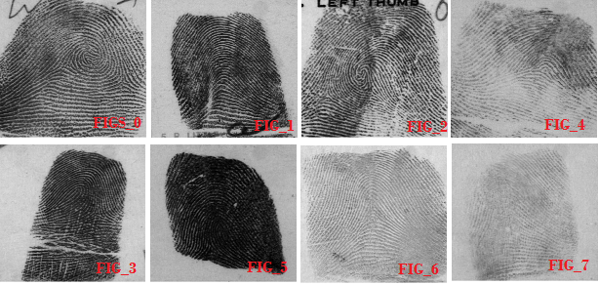
Recognition
NEURAL NETWORK
Process
Net
Perceptron
Input layer
Result
20 images from Oishi DB
FVC2002: 110 * 4 images
NIST Special Database 4
Training
Testing
Orientation map & Poincaré index.

Slide 71
Recognition
NEURAL NETWORK
Process
Net
Perceptron
Input layer
Result
20 images from Oishi DB 20x20 = 400 tests
2-layered: Error Min rate = 21,4 %
Training
Testing
Orientation map & Poincaré index.

Slide 72
Recognition
NEURAL NETWORK
Process
Net
Perceptron
Input layer
Result
20 images from Oishi DB 20x20 = 400 tests
2-layered: Error Min rate = 21,4 %
Training
Testing
Orientation map & Poincaré index.

Slide 73
Recognition
NEURAL NETWORK
Process
Net
Perceptron
Input layer
Result
20 images from Oishi DB 20x20 = 400 tests
3-layered: Error Min rate = 26,5 %
Training
Testing
Orientation map & Poincaré index.

Slide 74
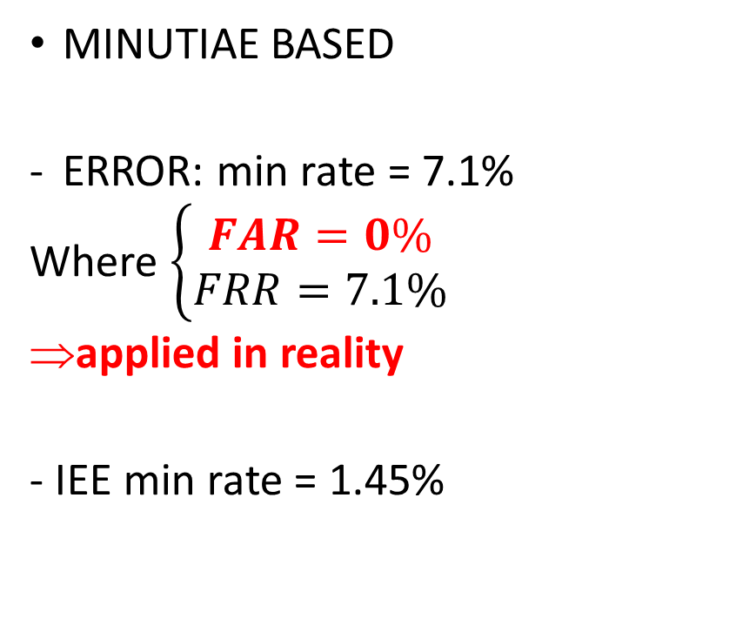
Recognition Results
MINUTIAE BASED
ERROR: min rate = 7.1%
Where $\left\{\begin{aligned}FAR=0\% \\ FRR=7.1\%\end{aligned}\right.$
applied in reality
- IEE min rate = 1.45%
ARTFFICIAL NEURAL NETWORK
Actual ERROR: min rate = 21.4%
IEEE Min rate = 19 %
=> More research continues
Training
Testing
Orientation map & Poincaré index.

Slide 75
Hardware Design

Slide 76






Architecture Overview
ENROLL
REQUEST
SYNCHORONIZE

Slide 77
Architecture Overview
ENROLL
REQUEST
SYNCHORONIZE
END DEVICE
SERVER SIDE

Slide 78
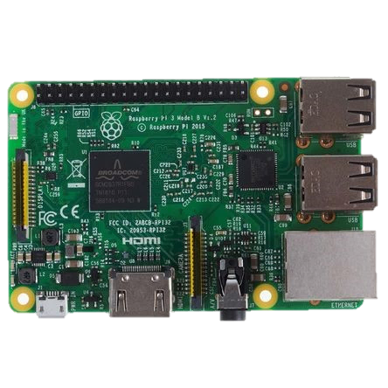
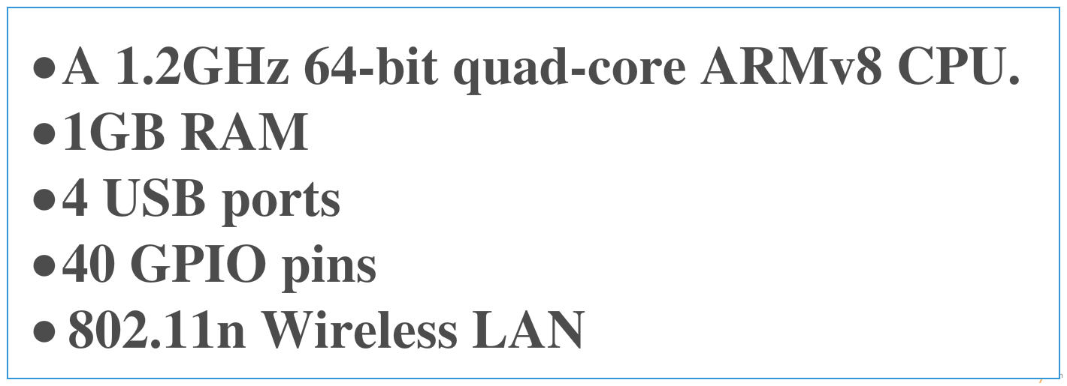
List of Hardware
Raspberry Pi3
LCD
USB-TO-COM PL2303
R305

Slide 79


List of Hardware
Raspberry Pi3
LCD
USB-TO-COM PL2303
R305

Slide 80





List of Hardware
Raspberry Pi3
LCD
USB-TO-COM PL2303
R305

Slide 81
List of Hardware
Raspberry Pi3
LCD
USB-TO-COM PL2303
R305

Slide 82
Application Module
User management module base on fingerprint recognition

Slide 83
Overview
WEB Application
FIS
module
Shop’s employee management
Company’s staff management
Family’s schedule application
Notes:
Hien nay tren thi truong … business =>
Xay dung module de xu ly cac data sau qua trinh nhan dang
Da ap dung => FIS WEB dap ung du yeu cau quan ly co ban cua 1 shop nho VD : quan ly nhan vien, thoi gian ….

Slide 84
FIS Module
Identify system
WEB Application
Attention LOG
FIS Module
User Data
Notes:
Module:

Slide 85






Compare
Notes:
Show 3 hinh xau : cac sp hien nay su dung :…. => tac hai : dashboard cung cap gioi han thong tin, khos trong cac tac vu phuc tap nhu dk nhan vien ….
Show tung hinh dep : so sanh : giao dien dep hon, truc quan hon, than thien, cung cap day du thong tin … chart : nhieu loi ich

Slide 86
Functional Requirement
Administrator
Manager
Employee
Use-cases
Notes:
Use case :
Gom 3 tang nhan vien : …
Admin : day du chuc nang …
Manager : tuong tu admin nhung thieu :….
Employee : chi co . ..

Slide 87
Non-functional Requirement
Interface: simple, easy to use
24/7
Easy to repair, add more function
Usability
Availability
Maintainability

Slide 88












Notes:
Sequence

Slide 89
Lesson Learned

Slide 90




Teamwork
Management Skill
Business Analysis
New Knowledge

Slide 91
DEMO - QA

